Slide 1

BANK LOAN APPROVAL
PREDICTIVE ANALYTICS PROJECT WITH R-PROGRAMMING

Slide 2
About the Project
The dataset for bank loans includes a crucial dependent variable, 'Personal.Loan,' where a value of 0 signifies a loan application was not approved, and a value of 1 indicates approval. The primary objective is to perform an in-depth Exploratory Data Analysis and then leverage advanced modeling techniques, including Logistic Regression, Decision Tree, and Linear Regression, to thoroughly assess and identify the most accurate and predictive model for loan approval. This analysis aims to provide significant insights and drive strategic decision-making in the loan approval process.

Slide 3

BUILDING AND PREDICTING WITH MACHINE LEARNING MODELS
The Bank Loan Approval model under-went three model integrations namely:
Logistic Modeling
Linear Modeling
Decision Tree Modeling

Slide 4
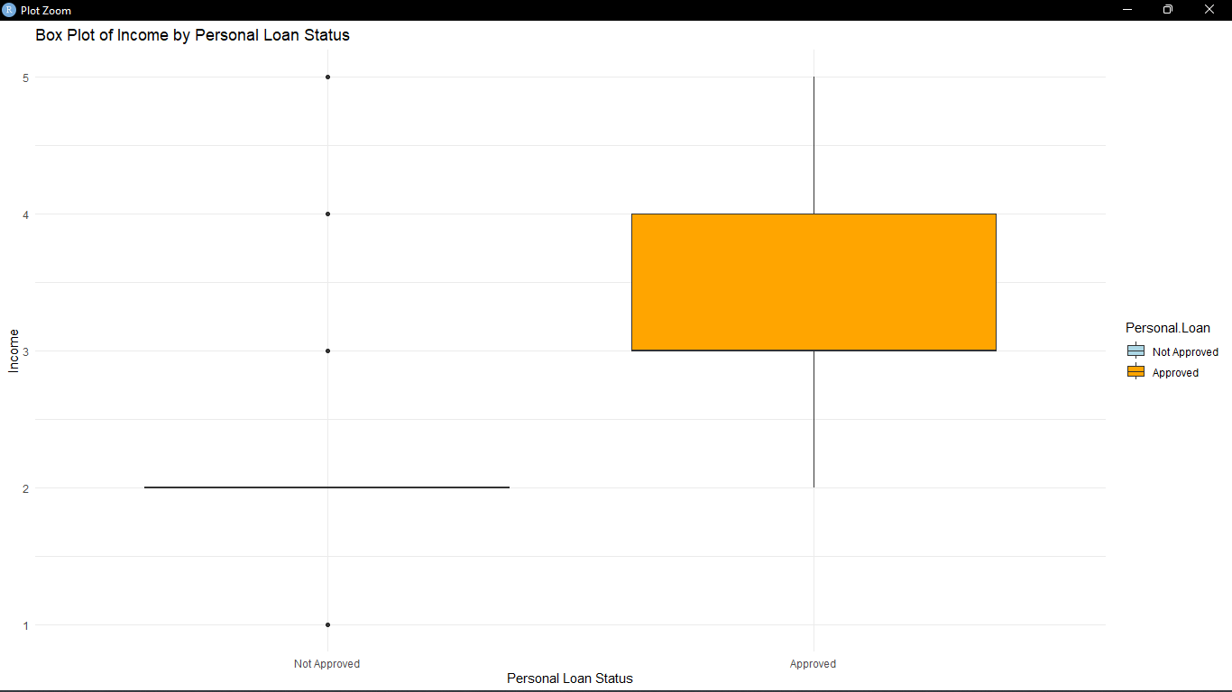
EXPLORATORY DATA ANALYSIS
DATA PROCESSING AND CLEANING
Missing Value : 0
Duplicates : 0
Feature Selection:
The relevant Data Attributes utilized :
Age,
Experience,
Income,
Family,
CCAvg,
Education,
Personal.Loan,
CreditCard,
Online,
CD.Account

Slide 5
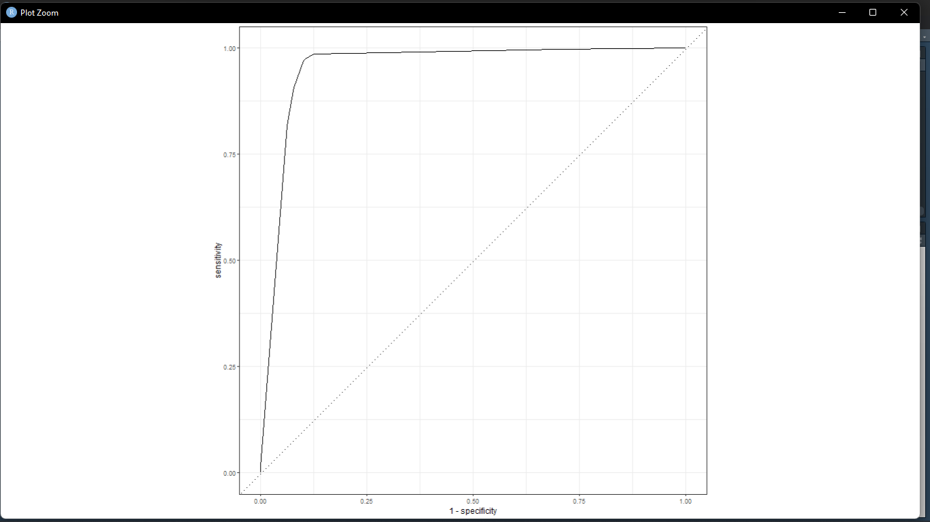
Logistic Modeling
Performance Metrics:
• Accuracy: 96.5%
This high accuracy indicates that the model correctly predicts loan approvals and denials 96.5% of the time.
•Sensitivity (Recall): 98.8%
Sensitivity is very high, suggesting the model is excellent at identifying approved loans (true positives).
•Specificity: 74.1%
This means that 74.1% of denied loans are correctly identified. The lower specificity compared to sensitivity indicates the model may have some trouble correctly identifying denied loans.
•ROC AUC: 0.0299
The very low ROC AUC value is unusual and indicates poor separability between the positive and negative classes. This might suggest issues with how probabilities are computed or applied.
Implications:
•While the model has high overall accuracy and sensitivity, the lower specificity could lead to more false positives (approving loans that should be denied).
•The very low ROC AUC suggests the probability estimates might not be reliable for ranking or threshold adjustment.

Slide 6

LINEAR REGRESSION MODEL
Performance Metrics:
RMSE (Root Mean Squared Error): 0.235
RMSE measures the average magnitude of the errors between predicted and actual loan statuses. Lower values indicate better model performance.
R-squared: 0.361
R-squared indicates that approximately 36.1% of the variance in the loan approval status is explained by the model. This is relatively low, suggesting the model doesn't capture all the relevant factors affecting loan approval.
Implications:
Linear regression is typically used for continuous outcomes, but here it's applied to a binary classification problem, which is less ideal.
The relatively low R-squared and RMSE indicate that this model might not be as suitable for classifying loans as the other models.

Slide 7
DECISION TREE MODEL
Performance Metrics:
Accuracy: 97.7%
This very high accuracy indicates that the model correctly predicts loan approvals and denials 97.7% of the time.
Sensitivity (Recall): 98.8%
Like logistic regression, this model has very high sensitivity, effectively identifying approved loans.
Specificity: 88.1%
Higher specificity means the model is better at correctly identifying denied loans compared to the logistic regression model.
ROC AUC: 0.0337
Similar to logistic regression, this low ROC AUC value suggests issues with probability estimates.
Implications:
The decision tree model has the best balance between sensitivity and specificity, making it more reliable for both approving and denying loans.
The high accuracy and relatively high specificity mean it minimizes both false positives and false negatives effectively.
The low ROC AUC, like in the logistic regression model, might require further investigation.

Slide 8
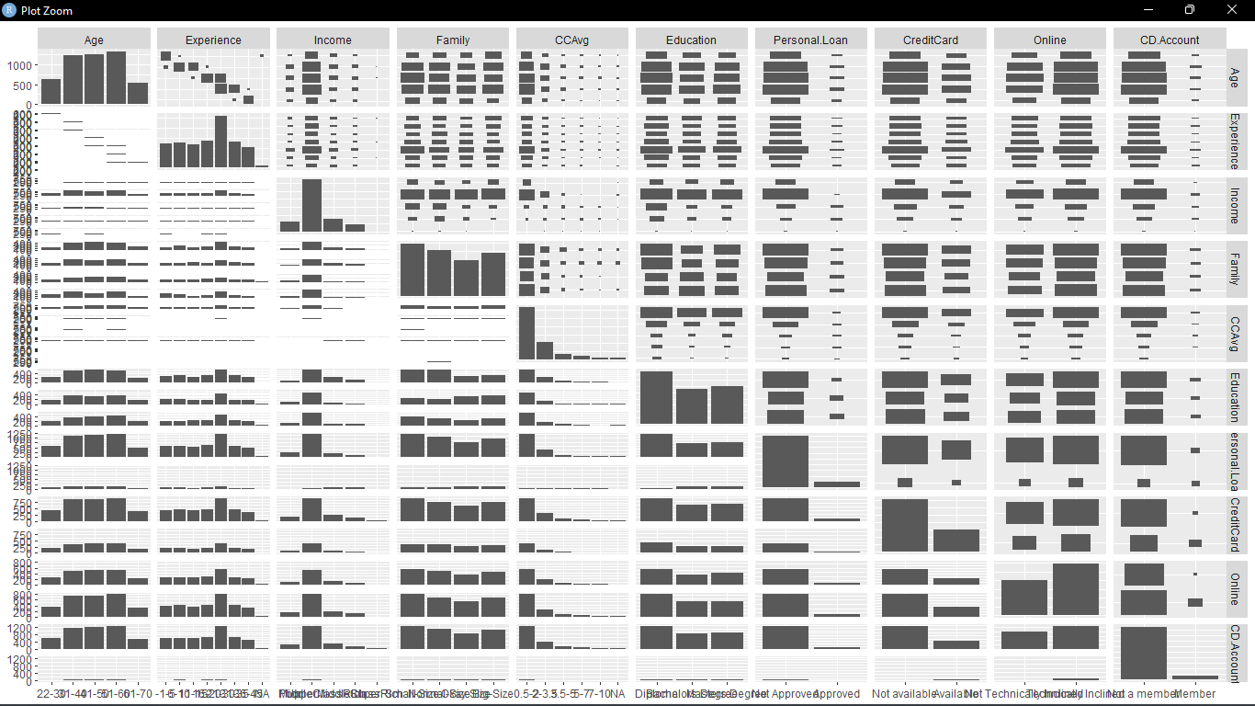
A CORRELATION GRAPH OF THE VARIABLES USED

Slide 9
OVERVIEW OF THE RESULTS
MODEL | LOGISTICS | DECISION TREE
ACCURACY | 0.965 | 0.977
SENSITIVITY | 0.988 | 0.988
SPECIFICITY | 0.741 | 0.881
ROC AUC | 0.0299 | 0.0337
Summary and Recommendations
• Logistic Regression: High accuracy and sensitivity but lower specificity and a problematic ROC AUC. Good at identifying approved loans but less reliable for denials.
• Linear Regression: Not ideally suited for binary classification. The low R-squared and RMSE suggest it doesn't capture all factors influencing loan approval.
• Decision Tree: Best overall model with high accuracy, sensitivity, and specificity. More reliable for both approving and denying loans. Needs investigation into the low ROC AUC.
NB:
Given the performance metrics, the Decision Tree model is recommended for the bank's loan approval and denial process due to its high accuracy, sensitivity, and specificity. Further investigation into the low ROC AUC values across models is suggested to ensure robust probability estimates.
Linear Regression
RMSE | 0.235
R-Square | 0.361

Slide 10

THANK YOU!
Giving Praise Frimpong
Phone:
+1 (925) 319-3108
Email:
praisefrimps619@gmail.com

